Slide 1
Parotid gland
By
Dr.Leena. N
Associate Professor
Department of Anatomy

Slide 2
Parotid gland
It is the largest of the Salivary glands.
Serous gland
Weighs about 25gm

Slide 3
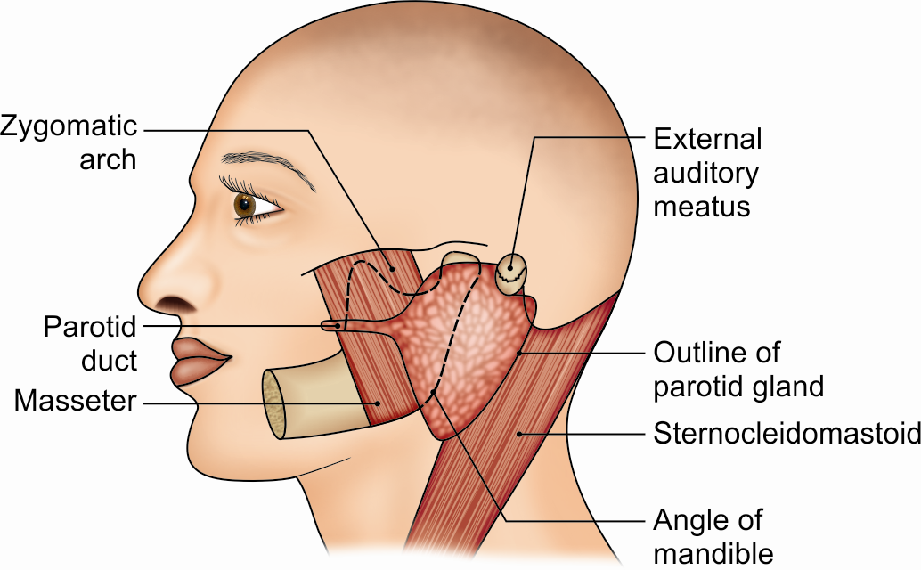
Position of parotid gland

Slide 4
Capsule of Parotid Gland
• The investing layer of the deep cervical fascia forms a capsule for the gland.
• It is supplied by great auricular nerve.
• A portion of the deep lamina, extending between the styloid process and the mandible, is thickened to form the stylomandibular ligament which separates the parotid gland from the submandibular salivary gland. The ligament is pierced by the external carotid artery.

Slide 5
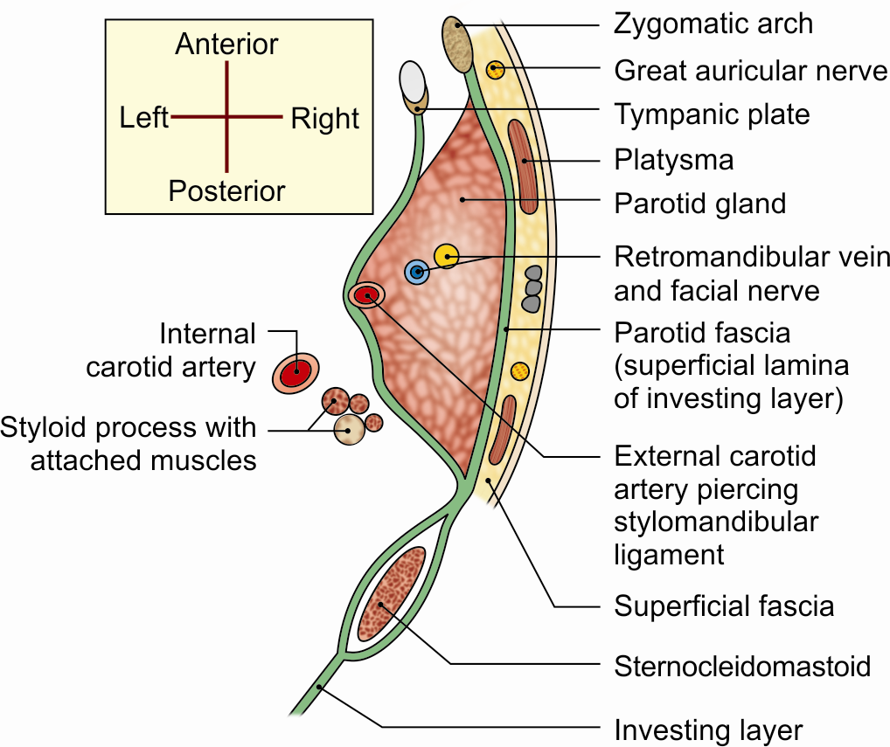
Capsule of the parotid gland

Slide 6
External Features
The gland resembles a three-sided pyramid.
The gland has four surfaces:
a. Superior (base of the pyramid)
b. Superficial
c. Anteromedial
d. Posteromedial
The surfaces are separated by three borders:
a. Anterior
b. Posterior
c. Medial/pharyngeal

Slide 7
Relations
Apex
The cervical branch of the facial nerve and the two divisions of the retromandibular vein emerge near the apex.
Surfaces
The superior surface or base It is related to
a. The cartilaginous part of the external acoustic meatus
b. The posterior surface of the temporomandibular joint
c. The superficial temporal vessels
d. The auriculotemporal nerve

Slide 8
Superficial surface covered with:
Skin
Superficial fascia
The parotid fascia
A few deep parotid lymph nodes
•

Slide 9
The anteromedial surface
It is related to:
The posterior border of the ramus of the mandible
The masseter
The medial pterygoid
The lateral surface of the temporomandibular joint.
The emerging branches of the facial nerve.

Slide 10
The posteromedial surface
Is related to:
The mastoid process, with the sternocido-mastoid and the posterior belly of the digastric.
The styloid process, with structures attached to it.
c. The external carotid artery and facial nerve enter the gland through this surface.

Slide 11
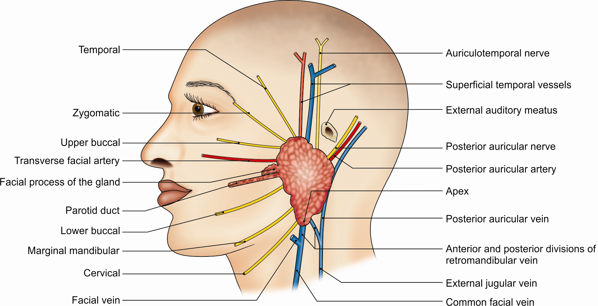
Structures emerging at the periphery of the parotid gland

Slide 12
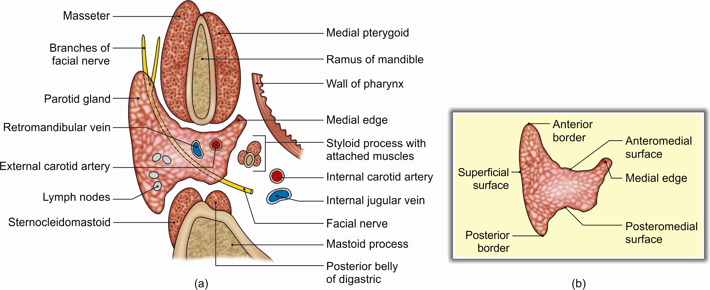
(a) Horizontal section through the parotid gland showing its relations and the structures passing through it, and (b) gross features of parotid gland

Slide 13
Structures within the Parotid Gland
From medial to the lateral side, these are as follows.
• Arteries: The external carotid artery divides into maxillary artery and superficial temporal artery
• Veins: The retromandibular vein
• The facial nerve
Facial nerve divides into two branches
a. Temporofacial: Divides into temporal and zygomatic branches.
b. Cervicofacial: Divides into buccal, marginal mandibular and cervical branches.
• Parotid lymph nodes

Slide 14
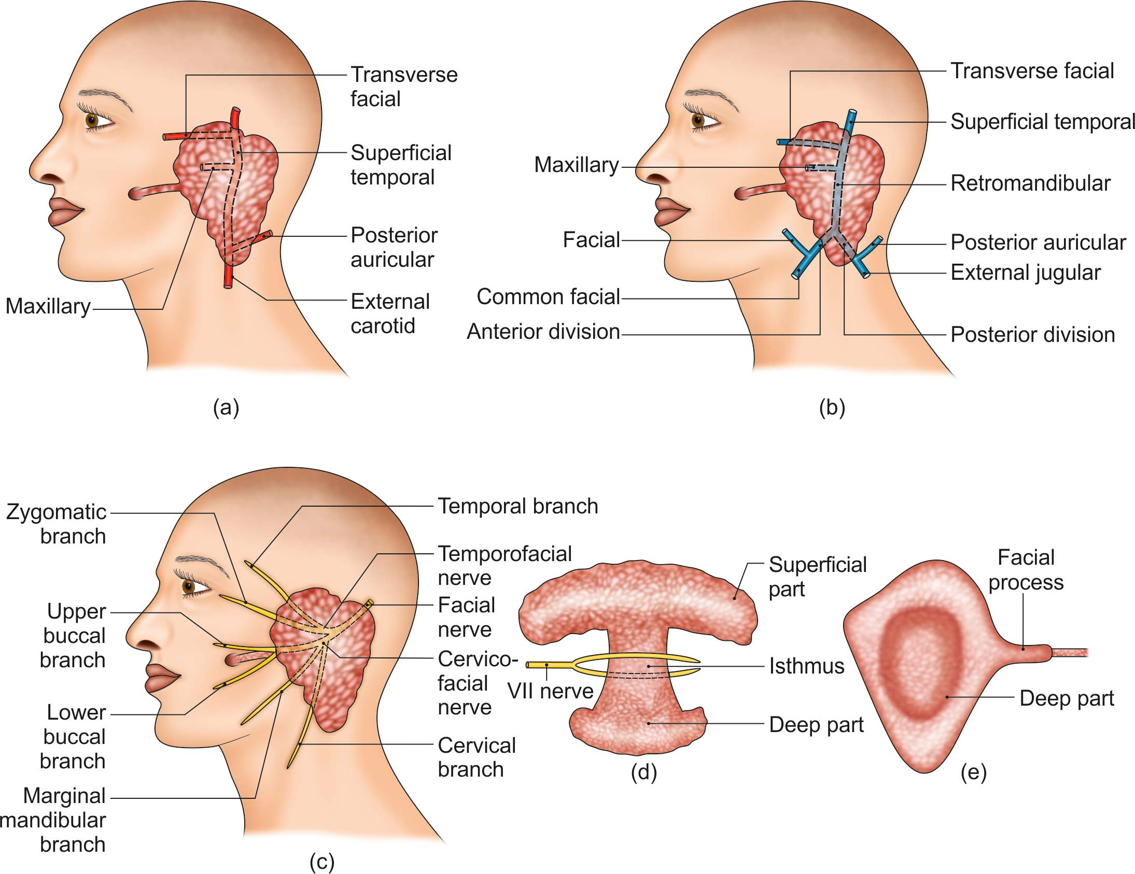
Structures within the parotid gland: (a) Arteries, (b) veins, (c) nerves, (d) two parts of the parotid gland are separated by isthmus, and (e) superficial part overlapping the deep part

Slide 15
Parotid Duct/Stenson’s Duct
Parotid duct is thick-walled and is about 5 cm long.
It runs forwards and slightly downwards on the masseter. It pierces buccal pad of fat , buccopharyngeal fascia and buccinator. Then forwards for a short distance between the buccinator and the oral mucosa. Finally, the duct turns medially and opens into the vestibule of the mouth opposite the crown of the upper second molar tooth.

Slide 16
Blood Supply
The external carotid artery and its branches that arise within the gland

Slide 17
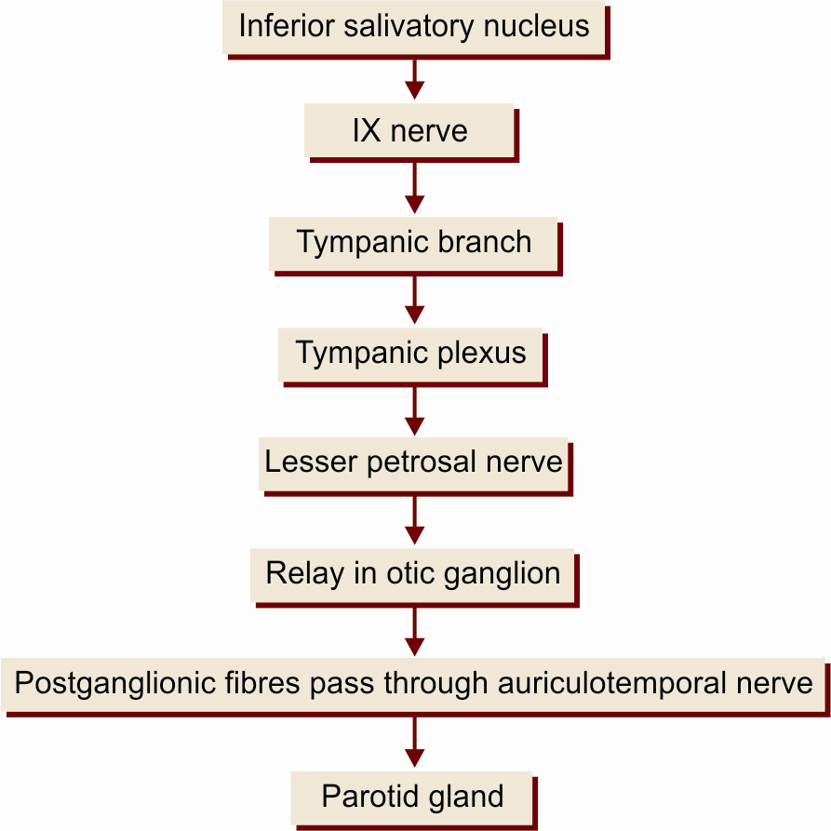
Nerve Supply

Slide 18
Lymphatic Drainage
Parotid Lymph Nodes
They drain:
a. Temple
b. Side of the scalp
c. Lateral surface of the auricle
d. External acoustic meatus
e. Middle ear
f. Parotid gland
g. Upper part of the cheek
h. Parts of the eyelids and orbit

Slide 19
Development
The parotid gland is ectodermal in origin.

Slide 20
CLINICAL ANATOMY
Viral infection of the gland- Mumps.
Parotid fascia is very dense and allows very little expansion of the gland . Hence parotid swellings are very painful.
Benign and malignant tumours.
Facial paralysis can occur as a result of involvement of facial nerve in a malignant growth of parotid gland.
During surgical removal of the parotid gland - Parotidectomy, the facial nerve is preserved by removing the gland in two parts, superficial and deep separately.
The parotid calculi may get formed within the parotid gland or in its Stenson’s duct.

